Slide 1
SECMP0062 and SECMP0067 Updates
DCC Update to SECAS and Working Groups

Slide 2
Contents
1
SECMP0062 Solution Overview
2
SECMP0062 Outstanding Issues and Concerns
3
Further Questions Raised by Industry and at TABASC
4
SECMP0067 Issues and Information
2

Slide 3
1
SECMP0062 Solution Overview
3

Slide 4
1
2
SECMP0062 User Story
Current State: Service Users receive alerts. Anomaly detection in the DSP counts the Alerts received from each device over a configurable time period. If a configurable threshold is reached (e.g., 60 Alerts in 30 minutes) then an anomaly event is recorded for investigation but no action is taken to stop Alerts being delivered to Service Users.
With SECMP0062 and if configured to do so, Service Users see a Service Management Incident when a device breaches the threshold for the first time. There will only be a new Incident if the Alert Code and Device combination has been continuously below the threshold for a configurable period of time. This “deadband” is proposed initially to be set to 24 hours.
With Alert Storm Protection Service Users will see only 1 in N alerts to (configurable).
Users will receive emails relating to Alert Storm Protection if they have chosen to use this common feature in the DCC Service Management System. This applies to all Incidents, not just Alert Storm Protection.
Service Users can view a dashboard in the Self Service Interface for details of devices and Alert Codes currently subject to Alert Storm Protection
4

Slide 5
2
62 Solution Design
Email to User
(if chosen)
Alerts to User
Alert Storm Dashboard
DSP
Message
Gateway
DSMS
Self Service
Interface
Alert
Anomaly Detection
Request
Manager
Incident creation
(If configured on)
Reporting
Database
Alert Storm Log
Alert threshold breach
triggers Alert Code
specific counting
Comms
Handler
DSMS
Existing Component
Only 1 in N Alerts
is passed on
Alert Storm
Protection
New Component
Alert Storm
Protection
CSP
Gateway
Discarded Alert Log
To DCC TOC
Alerts from devices
5
Notes:
Blue = New
Changes in Existing components also

Slide 6
3
2
Configuration Parameters
Alert Storm Protection Configuration | Value
Rolling Window (Time Period) for Alert Anomaly Detection | 1440 minutes
Amber Threshold for Alert Anomaly Detection | 15
Red Threshold for Alert Anomaly Detection | 20
Alert Code Specific Rolling Window (Time Period) | 1440 minutes
Alert Code Specific Threshold | 20
Alert Storm Protection Discarded Alert Limit | 500
Alert Storm Protection Maximum Time Limit | 1440 minutes
Alert Storm Protection Incident Deadband Period | 24 hours
Amber Threshold Incident Creation | Off
Red Threshold Incident Creation | Off
Alert Storm Protection Incident Creation | Off
Alert Storm Protection Exclusion List | 8F0A, 8F12, 8F1C, 8F72, 8F66, 8F67, 810E
Existing Alert counting parameters. A device generating more than 20 Alerts in 1440 minutes (1 day) will invoke Alert Code specific counting.
Alert Code specific counting parameters. A device generating more than 20 Alerts with a specific Alert Code in 1440 minutes (1 day) will invoke Alert Storm Protection for that Alert Code on that device.
Under Alert Storm Protection only 1 in 500 Alerts will be delivered to the User.
Under Alert Storm Protection, if the 500 limit is not reached within this time period then one Alert will be delivered to the User at this point.
A new Incident will not be created unless the Alert count has been below the threshold for a continuous 24 hour period.
All Incident creation can be turned off.
Any Alert Code in the exclusion list will never be subject to Alert Storm Protection. A full list will be discussed and agreed with Service Users.
6
6

Slide 7
4
2
DUIS Changes
To allow Service User systems to identify when Alert Storm Protection is being applied to a device, the DUIS schema will be enhanced to provide additional optional metadata in the header of Alert messages.
The following attributes will be added to the Alerts sent to the Service User during Alert Storm Protection:
ThrottledAlertSequenceID - An optional data item that identifies that this Alert Code is currently subject to Alert Storm Protection. If this attribute is included, it indicates a sequence number for this Alert message since Alert Storm Protection began.
ThrottledAlertDiscardedCount – An optional data item used to indicate the number of Alerts discarded since the last Alert message was forwarded to the Service User.
An example sequence of Alerts received by the Service User for a device generating 8F3E Alerts for some time that starts Alert Storm Protection:
Time Alert Code ThrottledAlertSequenceID ThrottledAlertDiscardedCount
11:30.00 8F3E not present not present
11:30.20 8F3E not present not present
11:30.40 8F3E not present not present
11:31.00 8F3E not present not present
11:31.20 8F3E not present not present
11:31.40 8F3E not present not present
11:32.00 8F3E 1 0
12:05.00 8F3E 2 99
12:38.00 8F3E 3 99
etc
7

Slide 8
2
Outstanding Issues and Concerns
8

Slide 9
• Incident Process and Problem management process needs defining/exploring. Needs to be confirmed who receives emails/reporting whether DNOs/Suppliers or both. Urgently needs an answer, otherwise it potentially makes things worse for DNOs.
The alerts are forwarded to the recipient configured in GBCS (Known Remote Party Role). For example:
many of the alerts such as 8014s (Power Factor Threshold Below) and 8015s (Power Factor Threshold Ok) go to the Network Operators
8F3E alerts (Unauthorised Communication Access attempted) go to the WAN Provider for CHF, Access Control Broker for PPMID, or Supplier (not CHF or PPMID)
PPMID alerts go to the Access Control Broker, but are delivered to the Supplier responsible for the related MPAN and/or MPRN.
As described in the User Story, there is a common feature in the DCC Service Management System that allows Users to choose whether or not they wish to receive email notification of Incidents. This feature is not specific to Alert Storm Protection, so Users will only receive emails about Alert Storm Protection Incidents if they have choose to use this common feature in the DCC SMS.
Note that Incident Creation and the email notifications could be turned off as they are not fundamental to the solution meaning that no incidents would be raised or email sent if requested.
9
Notes:
Statements from SECAS are in italics, DCC responses follow.

Slide 10
• 8F3E Alerts are causing major issues currently – 62’s solution either needs to cover this, or another Mod should be raised to deal with this alert. We need a definite answer by next Working Group meeting.
8F3E alerts (Unauthorised Communication Access attempted), are caused by a security alert from Zigbee devices on the HAN talking to another device, largely PPMIDs and GPF. Their impact on the DSP and Service Users can be managed by SECMP0062 in the same way as any other alert, on the assumption that they are not on the excluded alerts list.
Changes that may be required to address an existing CH defect are being looked at, and DCC have presented to SEC Operations on eradicating these alerts, including options for NOs to send Service Requests. There are separate fixes and changes to address these problems, but the main work would be at a different layer, the CSP layer. 62's key function is to protect the DSP and Service Users as part of the bigger "deliver protection in layers" approach.
The following slides show the origin and nature of alerts at present levels.
10
Notes:
There are 3 themes of addressing alert issues:
SECMP0062 addresses the input to the DSP
Comms Hubs
Meters

Slide 11
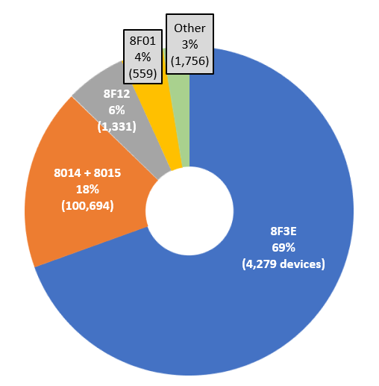
Daily Device Alert Count: 29m
% installed devices alerting: 2.18%
1
Device Alert by Type
Installed base : ~5m HAN devices with 109,000 devices generating > 300 device alerts per day.
8F3E – “Unauthorized Communication Access Attempted” i.e. a device (GPF, GSME and/or ESME) is reporting an unexpected device is trying to communicate with it. Sent to energy suppliers.
8014 and 8015 : “Power Factor Threshold below/ok.” These alerts are generated by ESMEs, sent to DNOs and appear as a pair.
8F12 : “CHF Device Log Changed”. Raised by Comms Hub. 95% of these hubs are located in the North region.
8F01 : Active Power Import above Load Limit Threshold. Generated by ESMEs.
11
28 Oct 2019 | DCC Controlled – SEC Parties
Notes:
HAN device = commissioned ESME, GSME, CHF, GPF, IHD, PPMID.

Slide 12
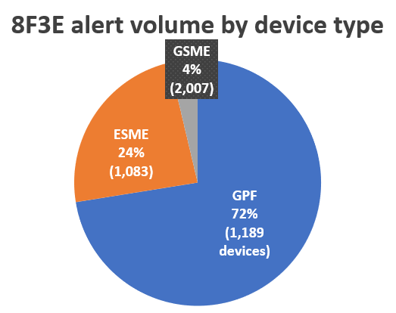
Daily 8F3E Alert Count: 20m
Number of alerting devices: 4,279
2
2
8F3E Alerts Overview
8F3E alerts are generated by a tiny fraction of the total commissioned devices (< 0.1%)
Average daily alert volume per device type:
GPF = 11,837
ESME = 4,272
GSME = 357
8F3E alerts are generated because of problems with the joins between devices on the HAN, either :
The join was never established. The solution is for the responsible supplier to send the missing join(s).
The joins were established correctly and have then spontaneously failed some time later. Root cause of why the joins “fail” is tracked via PBI000000116006. The workaround is for the responsible supplier to resend the join(s) to stop the alerts being generated.
12
28 Oct 2019 | DCC Controlled – SEC Parties

Slide 13
• TOC should be able to be pro-actively identify trends in spiking Alert Storms, is there any capacity for this to be used in the solution? And can it provide digestible information for Users on industry wide traffic?
The Technical Operations Centre (TOC) is a reporting and monitoring function, not a controlling one, and is around 15 minutes behind real-time in terms of providing results and analysis. The TOC does give profiles of trends, and a level of detail such as the type of meter. 62 works on a per-second basis with specific parameters designed to respond to alert storms in real-time and to protect the DSP and Service Users.
Discussions are going on between Users and DCC on how to configure the TOC reporting to provide useful information to the industry. DCC have established an way forward with suppliers to eradicate alert volumes.
13

Slide 14
• Terminology to change in reporting – something about emails (difference between investigations and application of pro-active notification). Harry clarified by saying he "wanted to confirm the means we are going to notify Users with. Will we be confirming somewhere the use of the ‘deadband’ method to reduce the number of emails, or will there be other means of notification before DUIS when the second stage of the solution is ready".
SECMP0062 is leveraging the existing notification and Incident creation mechanisms as described in the Solution Design and Configuration slides.
Email are set by a DSMS configuration and are not specific to Alert Storm Protection. Each User can set emails on or off.
The creation of Incidents is tied to SECMP0062, with a Configuration setting for all users of On and Off.
The deadband functionality is in place to control and reduce the number of emails and the creation of multiple incidents. An incident is created if the Device Level threshold and Alert Code threshold are breached. Once raised, the incident remains valid with no new incident unless the number of alerts falls below, and stays below, the threshold for a configurable deadband period (the initial configuration is for 24 hours). If the rate falls below the threshold, then rises above again, the rise is linked to the incident. This limits the number of incidents raised.
Note that there are five configuration parameters used to control Alert Code handling in addition to the Deadband function.
As mentioned on the DUIS Changes slide, changes to the Alert Structure specification within DUIS will provide real time notification of alert throttling.
14

Slide 15
• AD1s need mentioning and potentially monitoring in the wider solution. Non-AD1 channels were mentioned too. Arqiva can only send 5,000 requests to DSP per minute. Arqiva expected to handle 1000s of Alerts per second (according to Gary). Mafs from Scottish Power mentioned that Arqiva’s WAN failed when they tried putting through that number of alerts – they are therefore GBCS non-compliant.
Throttling of AD1s is part of the Code of Connection obligation for CSPs.
While the motorway for AD1s and non-AD1s is shared , the ingress to the DSP is different. The AD1s have their own APIs and throttling mechanism. Non-AD1s have a separate API but no throttling mechanism, which is what SECMP0062 is addressing.
GBCS Device
Alerts
AD1 DCC
Alerts
Core
DSP
GBCS Message API
Power Outage API
GBCS Device
Alerts
(via CSP systems
for CSP-N)
CSP
Comms
Hub
CHF Power Outage
Alerts
Device
15

Slide 16
• Arqiva talking to DSP – DSP messaging servers need to be questioned as to what amount of messages can they reliably receive, where is that limit?
For the Service Capacity – this is something that almost every Working Group member or Sub-Committee at some point has asked about. With both modifications, if the DCC Systems capacity was infinite then management would not be necessary. Therefore, one of the actions for investigation was for DCC to state what the current operating capacity through the DSP was to better understand why management is needed and to realistically know its limitations. This is something I have asked about a few times, but the 300 transactions per second is the only answer I have received with no further explanation. This is something everyone else seems to want further clarity on – such as how that correlates to Alerts and Service Requests.
Please note that the 300 transactions per second statement is an example number of Service Requests as noted in calculations for SECMP0067. It is not a statement of capacity.
We believe the question here is about what is the throughput capacity of the DSP to receive and process alerts? DSP has been performance tested to show it can work with a very high number of alerts / second.
We aren't even close to DSP throughput capacity at the moment. But Throughput Capacity of the system is not necessarily a useful indicator. As the number of installed devices increases, the platform will scale in line with projected demand, and will retain the operating capacity required. But a higher number of installed devices substantially increases the potential scale of alert storms. The bigger problem which is impacting operations right now is the DSP storage capacity to retain millions of Alerts if the recipient Service User system is unavailable. This capacity could be reached within a matter of hours if volumes continue to increase.
A key driver for this Modification is that 62 is a more economic, efficient, and cost-effective solution rather than buying storage, adding processing power, and boosting capacity to handle spurious alerts that no-one really wants – while keeping the ones people do need, moving.
16

Slide 17
• Enquiring further into CSP – reason stated for going with DSP was due to “aggregation layer” protection, is there any more detail we can add to that? Stance on CSP protection needs to be confirmed, if raising in future modification then we need to explicitly state that.
The DSP is the aggregation point for any traffic coming from devices and data being sent to Service Users, it is therefore a good point at which to provide Alert Storm Protection – not only protecting the DSP but also reducing the traffic being forwarded to the Users.
The CSP’s are now more aware of the impact of alerts and are working with the appropriate groups to identify potential solutions at the device level. As described above, throttling or consolidation of alerts could be implemented on the HAN device that is generating the alert, while fixes for devices will be implemented by Comms Hubs and Meter suppliers.
17

Slide 18
3
Further Questions Raised by Industry and at TABASC
18

Slide 19
• Does the scope of the modification include fixing the reason such a high number of Alerts has been generated? This came from concerns that the root cause of the issue has been ignored and a Device fix could solve it.
No the Modification is not scoped to fix device firmware issues generating alerts, but it is a protection mechanism for the DSP against them. The issue is a result of multiple devices, and only Meter and CH manufacturers can fix these problems. AS described above, this work is ongoing at this time.
19

Slide 20
• Do we know which Devices are most prone to generating Alert Storms at the moment – PPMIDs, Comms Hubs or others?
Yes, DCC are aware of the devices, and have shared this information with customers. See slide 12 above for sample device information
Specific details can be provided on a bilateral request. The following slides show sample historical and current information related to identifying and reducing alert volumes.
20

Slide 21
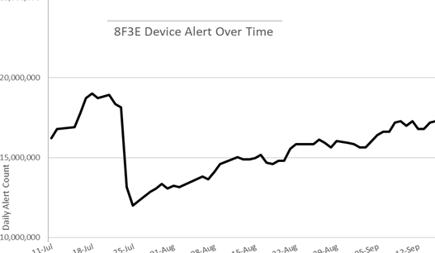
Sample Alert Volume Reduction
Reduction due to a supplier following recommended guidance
21

Slide 22
Daily 8014/8015 Alert Volume: 4.4m
Number of alerting devices: 100,694
3
8014/8015 Alert Overview
3 suppliers account for 96% of 8014/8015 alerts.
Supplier X 45 %
Supplier Y 40%
Supplier Z 9%
Status:
The alerts are specific to Honeywell-Elster ESMEs. The average alert volume is ~44 alerts per meter per day.
3 suppliers are responsible for 96% of 8014/8015 alerts by volume.
If the device is running the latest firmware the DNOs can stop the alerts by sending SRV 6.22 (Configure Alert Behaviours).
GBCS v3.2 states event/alert codes beginning 0x80 or 0x81 which relate to a GSME or ESME shall be configured not to alert prior to installation, i.e. in the meter firmware. See SECMP0018, due for implementation 24-Nov-19.
22
28 Oct 2019 | DCC Controlled – SEC Parties

Slide 23
8014/8015 Alert Volume
DNOs started to suppress alerts
on devices
23
28 Oct 2019 | DCC Controlled – SEC Parties

Slide 24
• Given the solution in the Impact Assessment explains that the Lead Supplier is notified if a PPMID is generating Alerts, do we know who is notified for other Devices? The Incidents management system needs to clearly state which User is getting notified when a Device/Alert combination is being filtered.
As noted in the first question above, the GBCS Known Remote Party Role configuration directs the alert.
• Where ‘deadband’ has been used, is there a number written in anywhere saying how long this is? TABASC said 24 hours, but not found in Impact Assessment.
The deadband functionality was proposed and introduced at a Working Group meeting, and will be fully documented in the Full Impact Assessment. The initial proposed value agreed at the Working Group was 24 hours, but this can be configured along with other parameters.
24

Slide 25
• An area of clarification needed regards the ability of the Arqiva network to process high throughput of alerts, of relevance for SECMP0062. I suggest that you get formal feedback from Arqiva on this point.
The original forecast volumes (ISFT Profiles 1-5) all had the same Alert profile equating to approximately 1 unsolicited Alert per meter per month. That gives a profile at full roll-out of approximately 2 million Alerts per day. As of October 2019, the DCC receives almost 2 million alerts per hour for an estate of only 2.5 million meters. At scale and at the current rate, device alerts could reach 450 million device alerts per day, which would equate to being nearly 200 times greater than contracted device alert volumes.
The contracted ISFT profiles provided by DECC, were the foundation for the architecture and scale of the service. While Service Providers can scale beyond these profiles, this will add additional cost to Service Users that is neither economic or of value to them given that many of these device alerts provide no or limited additional value if they are repeatedly triggered over the course of a day.
25

Slide 26
4
SECMP0067 Issues and Information
26

Slide 27
SECMP0067 User Story
Current State; There are no constraints placed on Service Users, the potential demand on the DCC solution is unbounded, placing considerable responsibility for cooperative behaviour on the part of Service Users.
For SECMP0067, Service Users will be notified of the DCC System Capacity and each Service User will be allocated a proportion of the available capacity for Service Requests by the DCC (based on an agreed algorithm).
If the DSP System usage exceeds the red threshold for DSP System Capacity and any Service User usage exceeds the red threshold for Service User Capacity, then a Service User Overload event will be recorded for each Service User and the DSP monitoring solution is notified. Any Service User who exceeds capacity will be notified and subject to Traffic Management. Then if the:
User sends a Service Request with an SRV identified as subject to Traffic Management, it is rejected and an HTTP 503 System Busy response returned to the Service User.
User sends a Service Request with an SRV identified as NOT subject to Traffic Management, it is processed as normal.
Traffic Management will continue until the System usage returns below the red threshold for System Capacity and stays there for a period longer than the system deadband duration. Once the period is complete, Traffic Management is turned off and the Service User notified.
27

Slide 28
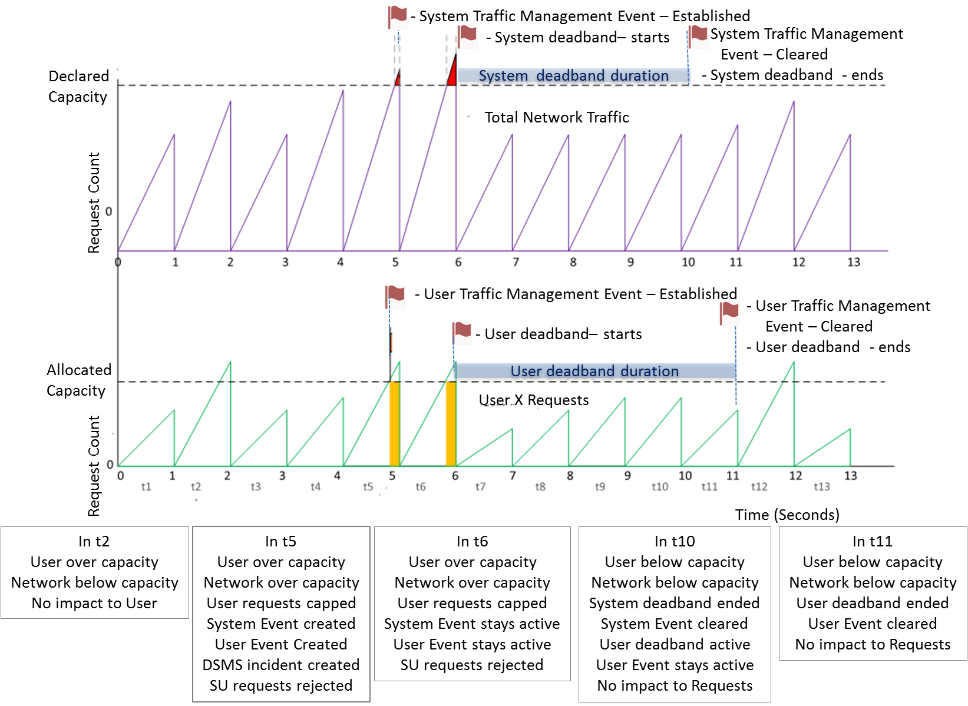
Traffic Overload Event Service User Processing
If the DSP system has reached System Capacity then the following applies:
Within each window, the DSP will accept SRs until the Service User reaches their Service User Capacity. At this point, the Service User will be marked as subject to Traffic Overload for the remainder of that window.
The processing at the DSP boundary within the Message Gateway will check whether a Service User is marked as subject to Traffic Overload and if so :
• Any SR with an SRV identified as subject to Traffic Management will be rejected and an HTTP 503 System Busy response will be returned.
• Any SR with an SRV identified as NOT being subject to Traffic Management will be processed as normal.
The processing under Traffic Management mode will continue until System usage returns below the red threshold and stays there for a period greater than the system deadband duration.
During deadband period if the system goes over capacity no new event is created, but is linked to the existing traffic management event.
Once the rate of messages falls within the system capacity then the deadband window is restarted. This will reduce the number of incidents.
Once Service User returns below red threshold they will be cleared of being subject to Traffic Overload.
Current state of System and Service User usage will be made available to the DSP Monitoring solution so it can be displayed and, if required, exported to other systems.
Configuration Parameters
List of SRVs are subject to Traffic Management
Deadband for System and User
System Allocation per Service User
28

Slide 29
• Defining the window of time the mechanism in the Mod remains active for (a few seconds on average or is it longer?). Note that if longer, this will require additional analysis from Sub-Committees. In the Preliminary Assessment, “𝑆𝑇𝑇_𝐷𝑀𝑗 = Defined Total Capacity” has been put for Total Capacity and a defined capacity of 300 transactions per second. Is this correct in all instances and possible to give as a straightforward answer to Working Group members?
The mechanism is designed to operate on a per second basis, but events which extend over minutes, such as in the case of a single service user where errors in their systems trigger the transmission of large volumes of service requests beyond the capabilities of the service that last minutes will require the mechanism to be engaged for minutes on that service user.
The rate of 300 transactions per second was provided as part of the worked example and for illustrative purposes only. The actual capacity of the system will be stated each month as part of the formal capacity allocation process.
29

Slide 30
• The calculation used for allocating Service Capacity needs “Layman’s Terms” definition, both for Legal Text writing and to help provide guidance for SEC Parties. The only one provided is in the Preliminary Assessment, how would you explain it to someone with no SEC background?
A simplified view of the allocation formula has been provided:
30

Slide 31
• ADTs need looking into and how they affect the solution, can DCC confirm how these will affect the solution?
Anomaly Detection Thresholds (ADTs) are a different aspect of DSP functionality and don’t have any impact on the SECMO0067 solution. ADTs are generally set to detect anomalous behaviour against forecast usage over a relatively long time period – currently most ADTs operate over a 24 hour period. Even though much shorter time periods can be set, these are not granular enough to protect against the sort of systematic error or Denial of Service (DDOS) attack that SECMP0067 is looking to prevent by operating on a per second basis.
Notwithstanding the issue of granularity, the processing of the breach of an ADT threshold results in messages being placed in quarantine rather than being rejected, which doesn’t help the solution since the message still has to be fully processed by the DSP in order to be placed in quarantine.
31
Notes:
DDoS attacks can run from seconds to days

Slide 32
• On the question of the cost for SECMP0067 – we’ve had this question come up from the Working Group, TABASC and recently SSC. The most recent person to ask about this was Julian Hughes ... The rationale (as was echoed by members of the Working Groups and Sub-Committees) for asking why should industry be paying for the modification came down to suggesting that the industry members who currently pay to use the DCC Systems expect to receive and send all Service Requests and Alerts without issue, with the exception of notified System maintenance and genuinely unforeseen circumstances. As far as ‘business as usual’ obligations went, a lot of them take the view that this should be provided as standard.
67 prevents the loss of key Service Requests in the case of exceptional events, such as weather event or a Service User exceeding their remit and flooding the system with spurious or incorrect Service Requests, rather than a Business As Usual situation. 67 is a more economic, efficient, and cost-effective solution rather than buying storage, adding processing power, and boosting capacity to handle occasional or rare events and situations.
32

